Slide 1
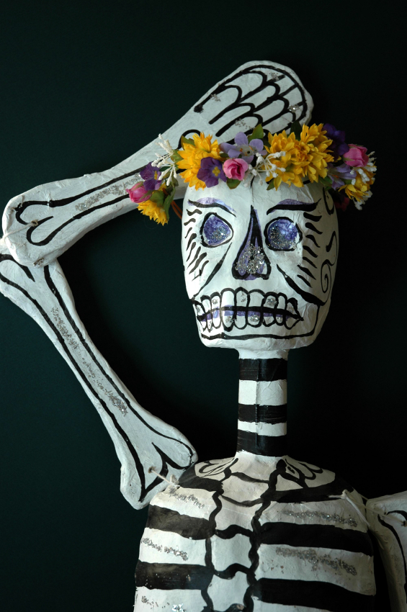
¿Ser o Estar?
To be or To be?
¡Esa es la pregunta!
#1

Slide 2
In English, the “to be” verb is used to describe people and things in a variety of ways:
  Adriana is nice.
  Our school is small.
  I am tired.
  The books are on the table.

Slide 3
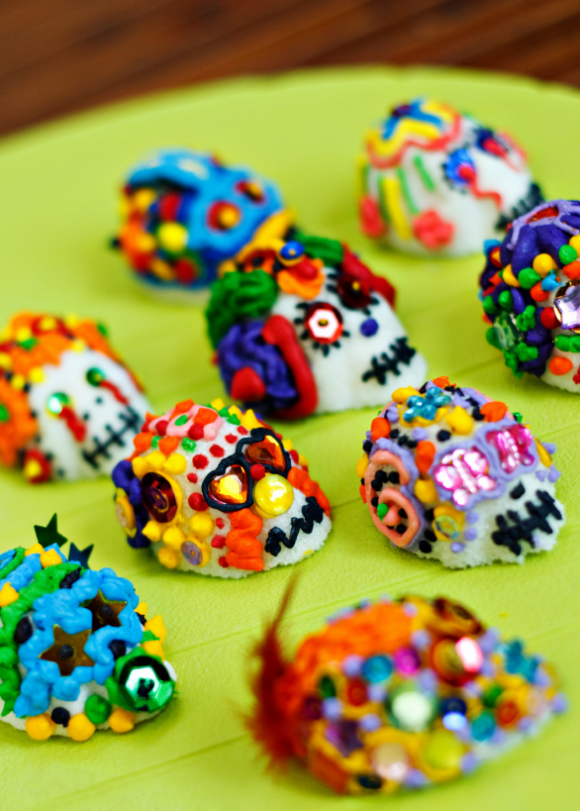
In Spanish, however, there are two ways to say “to be”:
ser
estar
and they are used in different situations.
In this first presentation, we will study “ser” and it’s uses.

Slide 4
First, the forms of the verb ser:
Inglés | Español
I am | yo soy
You (familiar) are | tú eres
He is She is You (formal) are | él es ella es usted es
We are | nosotros somos
You (plural, familiar) are – used in Spain | vosotros sois
They are You (plural, formal) are | ellos son ustedes son

Slide 5
To remember when to use “ser” and when to use “estar” use the following mnemonic device:
DOCTOR
ser
EVE
estar
HELPP

Slide 6
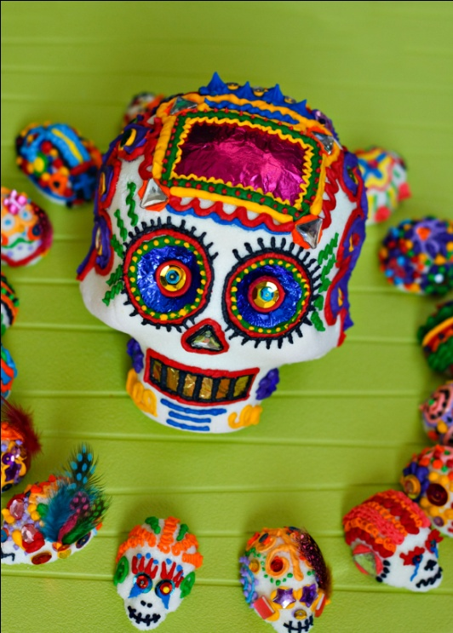
Ser is used to talk about:
Description
Origin
Character
Time
Occupation
Relationship
Events

Slide 7
Description (of people or things)
  Mi abuelo es alto.
  Nuestra escuela es pequeña.
Origin (such as nationality)
  Nuestros tíos son de Guatemala.
  Justo es argentino.
Character (personality)
  Adriana es simpática.
  Mis profesores son inteligentes.

Slide 8
Time (hour, day, week, etc.)
  Son las nueve y veinte.
  Es lunes.
Occupation (also identification)
  Sra. Johnson es profesora.
  Yo soy estudiante.
Relationship (also possession)
  Somos amigos.
  Ella es mi prima.
  ¿Es mi libro or tu libro?

Slide 9
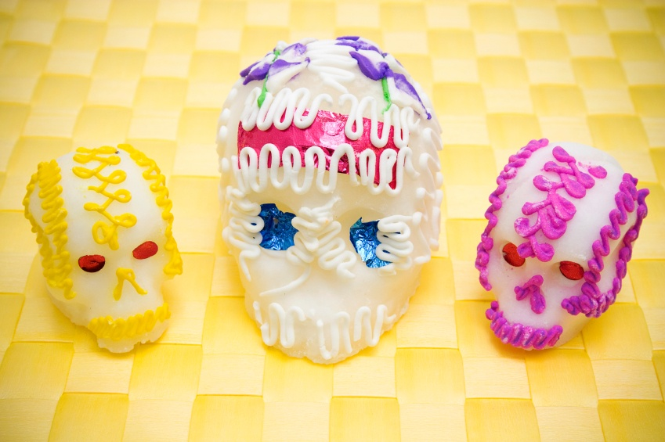
Event (location, time, date)
  El baile es en el gimnasio.
  El concierto es a las siete.
Click here to review the uses of ser again
Click here to practice using ser

Slide 10
Practica
1.________ las ocho de la mañana.
2. Yo________de Chile.
3. El cuaderno negro _____de Marcos
4. Mis clases _________ difíciles.
Nosotros ________ graciosos.
Pablo __________ mi tío.
La película ________ a las ocho.
Son
soy
es
son
somos
es
es

Slide 11
¡Práctica divertida con “ser”!
Canta Con Justo
Click here to sing the song “Eres Tú” with Justo Lamas at justolamasgroup.com
Practica la Canción
Click here to see a video of the original song and how well you know the lyrics to “Eres Tú” by playing a game at lyricstraining.com.

