Slide 1
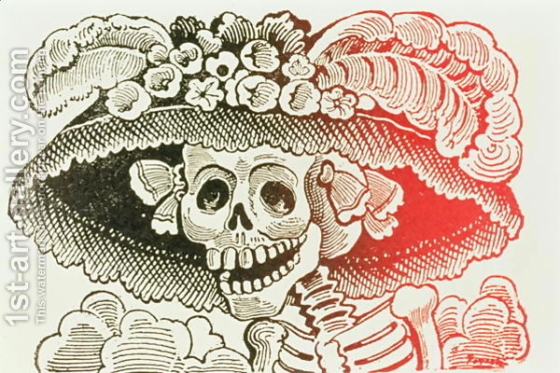
José Guadalupe Posada

Slide 2
An internet study: José Guadalupe Posada
Step Uno: use an online dictionary or your own knowledge to define the following ENGLISH words in ENGLISH. Put the definitions in your own words!
  aristocrat
  dictator
  lithograph
  lampoon
  satire

Slide 3
Posada…continued
Step Dos: Now read the following article about Jose Guadalupe Posada:
Day of the Dead art
José Guadalupe Posada: Father of La Catrina
by Theresa Cano
azcentral.com
Since his death nearly a century ago, José Guadalupe Posada's work has steadily gained popularity with art lovers and Día de los Muertos celebrators alike. He is especially known for his calaveras images of whimsical skeletons.
Posada, born in 1852 in the Mexican state of Aquascalientes, began his career as a teacher of lithography. In 1887, he moved to Mexico City where he worked as an illustrator for hire.
His work reflected the times in which he lived. While a vast majority of the poverty-stricken population was illiterate, Posada's illustrations made the stories, news articles, broadsides, advertisements and the many other items his work accompanied easy to grasp.

Slide 4
José Guadalupe Posada: Father of La Catrina
Eventually settling down as the chief illustrator for Antonio Vanegas Arroyo in Mexico City, Posada created nearly 20,000 images during his career.
During Posada's time working for the publisher, dictator Porfirio Díaz's rule over Mexico City was not one that was celebrated by its citizens. Posada's illustrations clearly showed the general feeling of disdain for the corrupt government, helping to mold negative public opinion of Díaz and the company he kept.
Posada was regarded as the voice of the common man and helped to solidify art as a means to communicate the public's unhappiness and skepticism of the government. He used the practice of caricaturizing figures as skeletons to serve as a sort of satirical obituary. While he lampooned people of all classes, it was his rendering of the aristocrats, whom Díaz held in such high regard, that remains the most popular of Posada's vast catalog work.

Slide 5
José Guadalupe Posada: Father of La Catrina
"La Catrina," is one such image. While the illustration of the high society woman is one of Posada's most highly regarded pieces, it's also arguably the most recognizable image of the Día de los Muertos celebration.
In fact, many of Posada's calaveras can be seen at Día de los Muertos festivals today. The Caretas (masks) worn at the end of the celebrations to scare the dead away from their altars are often times either reproductions of or influenced by Posada's illustrations.
The style and sentiment in Posada's work fueled an artistic movement in the years following his death in 1913. Muralists Diego Rivera and José Clemente Orozco, who became heavyweights in the Mexican art community, both named Posada as a major influence on their work.
While he was alive, Posada received what amounted to just a few cents for each of his drawings. He lived a humble life and upon his death, was buried in a common grave, though there was nothing ordinary about him.

Slide 6
Jose Guadalupe Posada
Step Tres: Follow the link and watch at least 2 minutes of the presentation showing work by Posada.
The Art of Jose Guadalupe Posada video
Step Cuatro: Now look at the following pictures and complete the questions.

Slide 7
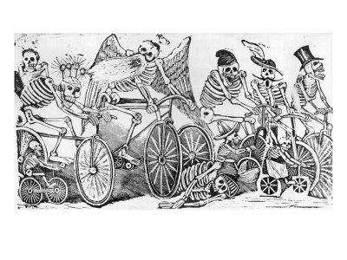
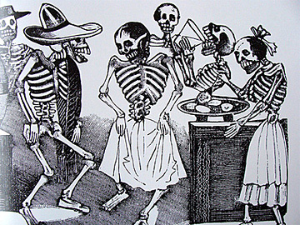
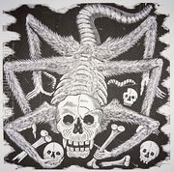
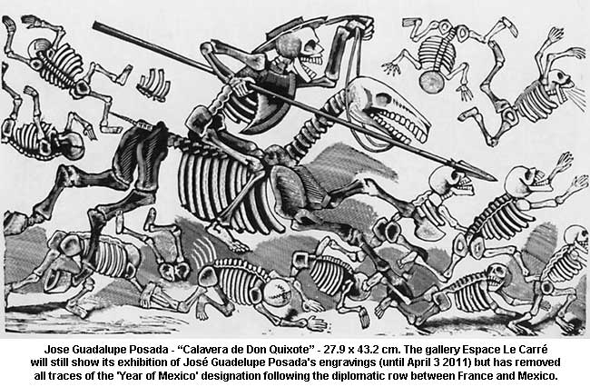
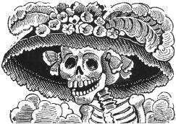
1
2
3
5
4

Slide 8
1. Which one is your favorite? Why?
2. Now choose another of the drawings and tell its story in a few sentences. Who is pictured? What are they doing? What kind of life do they live?
From what you read in the article and what you have seen in his work, what point to you think Posada was trying to get across with his work? (What was his motive for drawing what he did?)
4. Who are some modern day individuals or groups that would make interesting calaveras?

Slide 9
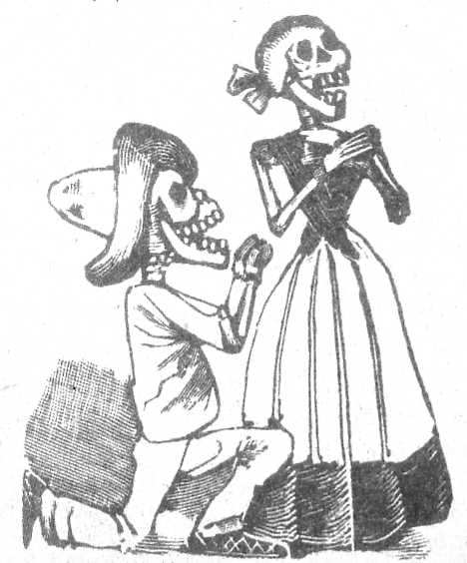
Be prepared to share the answers you wrote down with your classmates!
¡Adios!

